Slide 1

CSE- 4105
Md. Manowarul Islam
Lecturer
Department of CSE
Jagannath University

Slide 2
Basic of line
A line segment in a scene is defined by the coordinate positions of the line end-points
y
(7, 5)
5
2
(2, 2)
2
7
x

Slide 3
Basic of line
Line drawing is accomplished by calculating intermediate positions along the line path between specified end points.
Y=mX+B
A slope of 2 means that every 1-unit change in X yields a 2-unit change in Y.
m
B

Slide 4
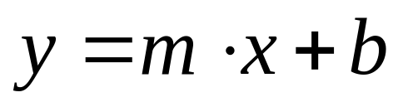
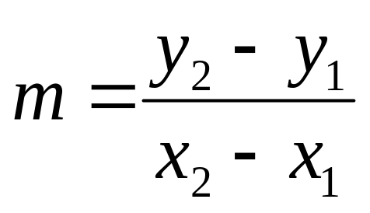
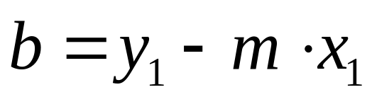
Line Equations
Let’s quickly review the equations involved in drawing lines
y
where:
y₂
y₁
x₁
x₂
x

Slide 5
Algorithm
Start at the pixel for the left-hand endpoint x₁
Step along the pixels horizontally until reach the right-hand end point x₂
For each value of x compute corresponding y value
Round this value to nearest integer to select the nearest pixel
Basic Algorithm:
For x= x₁ to x₂
y=mx+b
PlotPixel(x,round(y))
End;
Problems: Lot of computation and inefficient.
For each iteration: 1 float multiplication, 1 addition, 1 round

Slide 6
A Very Simple Solution
5
4
3
2
1
0
0
1
2
3
4
5
6
7

Slide 7
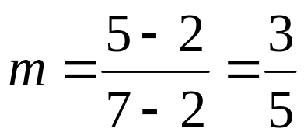
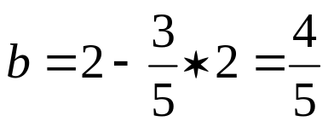
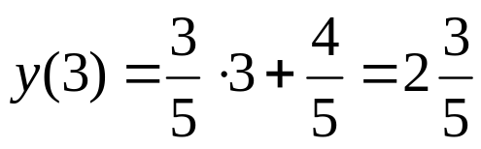
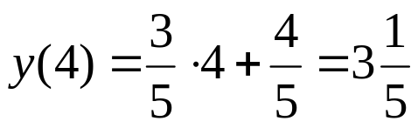
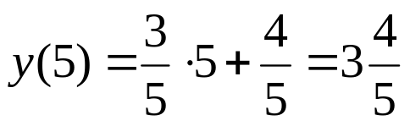
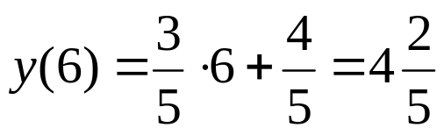
A Very Simple Solution
y
(7, 5)
First work out m and b:
5
2
(2, 2)
2
3
4
5
6
7
x
Now for each x value work out the y value:

Slide 8
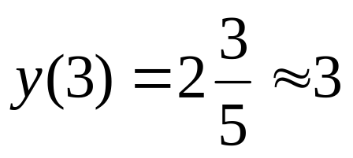
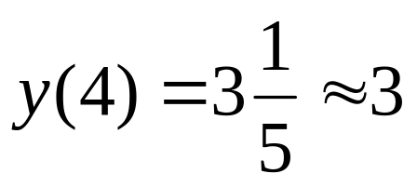
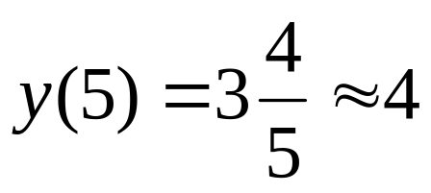
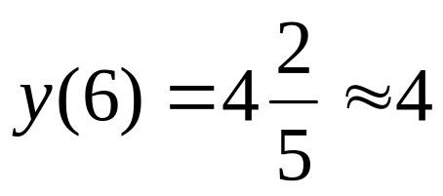
A Very Simple Solution
Now just round off the results and turn on these pixels to draw our line
7
6
5
4
3
2
1
0
0
1
2
3
4
5
6
7
8

Slide 9
A Very Simple Solution
However, this approach is just way too slow
In particular look out for:
  The equation y = mx + b requires the multiplication of m by x
  Rounding off the resulting y coordinates
We need a faster solution
Problems: Lot of computation and inefficient.
For each iteration: 1 float multiplication, 1 addition, 1 round

Slide 10
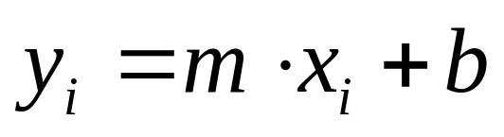
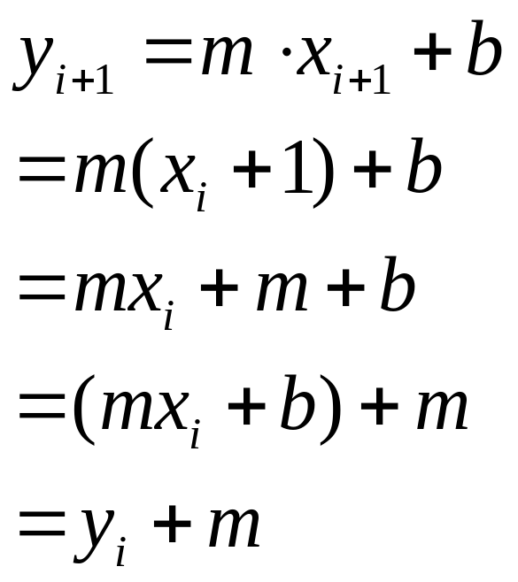
Line Equations
The equation of a simple line is:
Modify the equation:
Replace by y_{i}

Slide 11
The DDA Algorithm
The digital differential analyzer (DDA) algorithm takes an incremental approach in order to speed up scan conversion
Simply calculate y_{k+1} based on y_{k}

Slide 12
The DDA Algorithm (cont…)
Consider the list of points that we determined for the line in our previous example:
(2, 2), (3, 2³/₅), (4, 3¹/₅), (5, 3⁴/₅), (6, 4²/₅), (7, 5)
Notice that as the x coordinates go up by one, the y coordinates simply go up by the slope of the line
This is the key insight in the DDA algorithm
Basic Algorithm:
For x= x₁ to x₂
PlotPixel(x,round(y))
y=y+m
End;

Slide 13
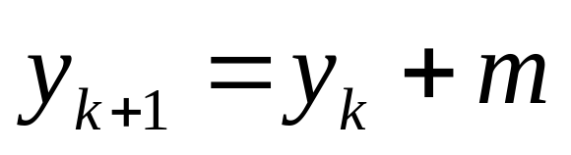
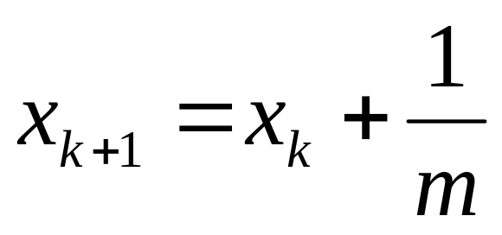
The DDA Algorithm (cont…)
When the slope of the line is between -1 and 1 begin at the first point in the line and, by incrementing the x coordinate by 1, calculate the corresponding y coordinates as follows:
When the slope is outside these limits, increment the y coordinate by 1 and calculate the corresponding x coordinates as follows:

Slide 14
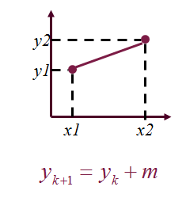
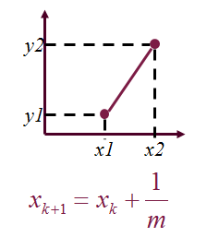
DDA Algorithm
Digital Differential Analyzer
  0 < Slope <= 1
    Unit x interval = 1
  Slope > 1
    Unit y interval = 1

Slide 15
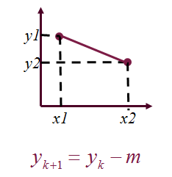
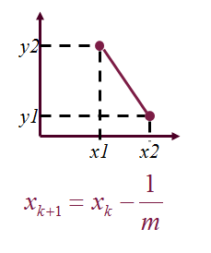
DDA Algorithm
Digital Differential Analyzer
  -1 <= Slope < 0
    Unit x interval = -1
  Slope < -1
    Unit y interval = -1

Slide 16
The DDA Algorithm Summary
The DDA algorithm is much faster than our previous attempt
  In particular, there are no longer any multiplications involved
However, there are still two big issues:
  Accumulation of round-off errors can make the pixelated line drift away from what was intended
  The rounding operations and floating point arithmetic involved are time consuming

Slide 17
Thank You

